Slide 1
Frontend Development
ICT- Training Technical Skills

Slide 2
MVC
Model View Controller or MVC as it is popularly called, is a software design pattern for developing web applications. A Model View Controller pattern is made up of the following three parts −
Model − The lowest level of the pattern which is responsible for maintaining data.
View − This is responsible for displaying all or a portion of the data to the user.
Controller − Software Code that controls the interactions between the Model and View.

Slide 3
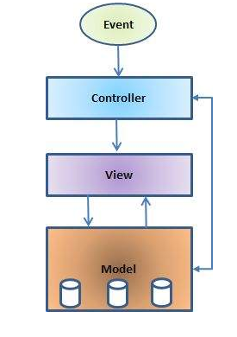
MVC Architecture

Slide 4
MVC Explain
The Model
The model is responsible for managing the data of the application. It responds to the request from the view and it also responds to instructions from the controller to update itself.
The View
It means presentation of data in a particular format, triggered by a controller's decision to present the data. They are script-based templating systems like JSP, ASP, PHP and very easy to integrate with AJAX technology.

Slide 5
MVC Explain
The Controller
The controller is responsible for responding to the user input and perform interactions on the data model objects.
The controller receives the input, it validates the input and then performs the business operation that modifies the state of the data model.

Slide 6
React JS
React is a free and open-source front-end JavaScript library for building user interfaces based on UI components.
React components implement a render() method that takes input data and returns what to display.
The React.js framework is an open-source JavaScript framework and library developed by Facebook.
ReactJS is a declarative, efficient, and flexible JavaScript library for building reusable UI components.

Slide 7
React Components
A Component is one of the core building blocks of React.
React components are independent and reusable code. They are the building blocks of any React application.
DOM
Interact with a HTML document.
The Document Object Model (DOM) is an application programming interface (API) for HTML and XML documents. It defines the logical structure of documents and the way a document is accessed and manipulated.

Slide 8
Virtual Dom
A virtual DOM is a lightweight JavaScript representation of the Document Object Model (DOM) used in declarative web frameworks such as React, Vue. js, and Elm.
Updating the virtual DOM is comparatively faster than updating the actual DOM (via JavaScript).

Slide 9
Create React App
npx create-react-app my-react-app
cd my-react-app
npm start

Slide 10
npm
The name npm (Node Package Manager) stems from when npm first was created as a package manager for Node.js.
All npm packages are defined in files called package.json.
The content of package.json must be written in JSON.
At least two fields must be present in the definition file: name and version.
npm is the world's largest Software Registry.
The registry contains over 800,000 code packages.

Slide 11
npx
The npx stands for Node Package Execute and it comes with the npm, when you installed npm above 5.2.0 version then automatically npx will installed.
It is an npm package runner that can execute any package that you want from the npm registry without even installing that package.
The command npm is used to download JavaScript packages from Node Package Manager,
and npx is used to execute JavaScript packages downloaded this way.

Slide 12
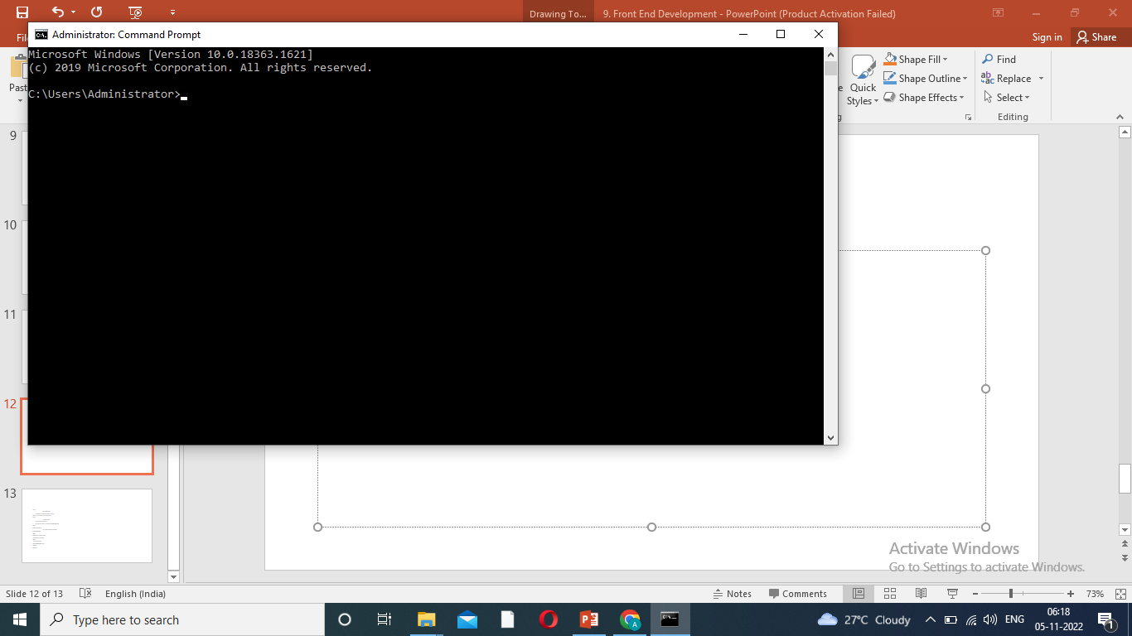
How to create Reactjs App
Step 1:
Go to Command Prompt – open.

Slide 13

Continue..
Step 2:
Check node version.
Type- node –v or node –version Press enter key.
Node js is not installed. Install to continue work.

Slide 14
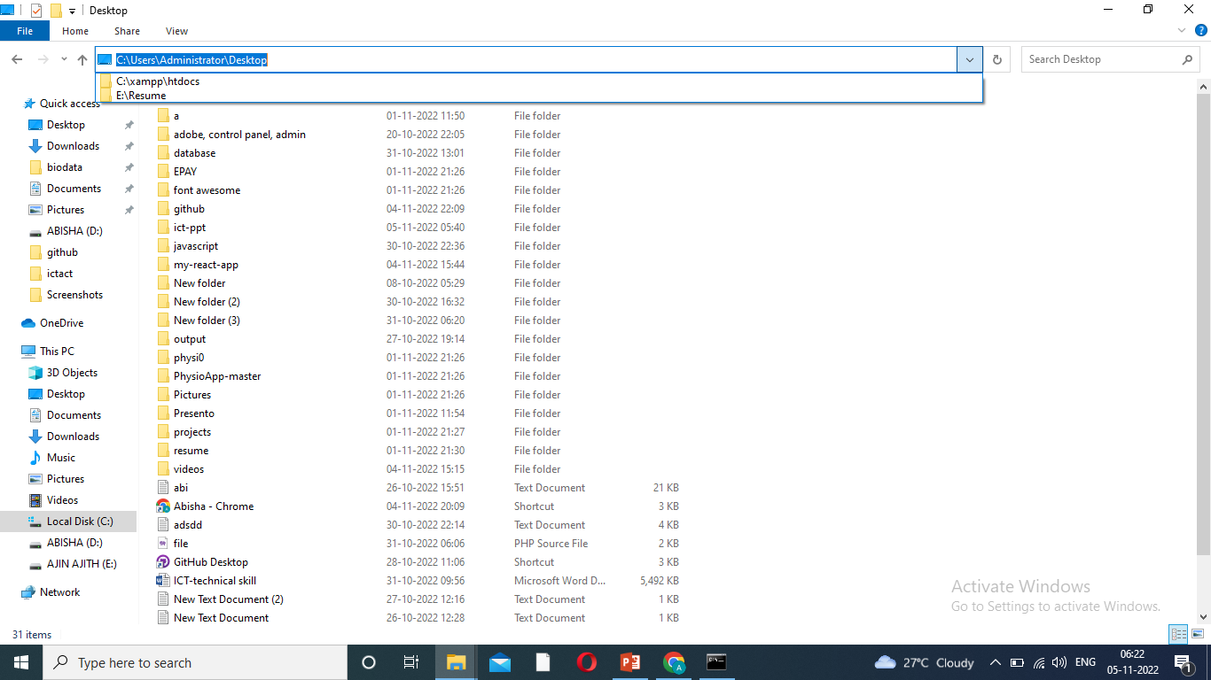
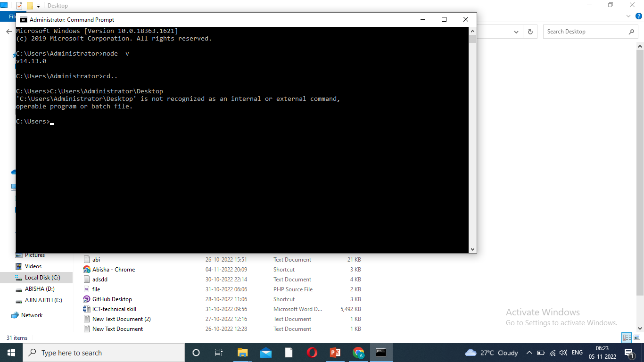
Continue..
Step 3:
Drive path connect.
Then type cd.. Press enter key.
Drive path copy and paste. Eg. Cd C:\user\Admins\Desktop

Slide 15
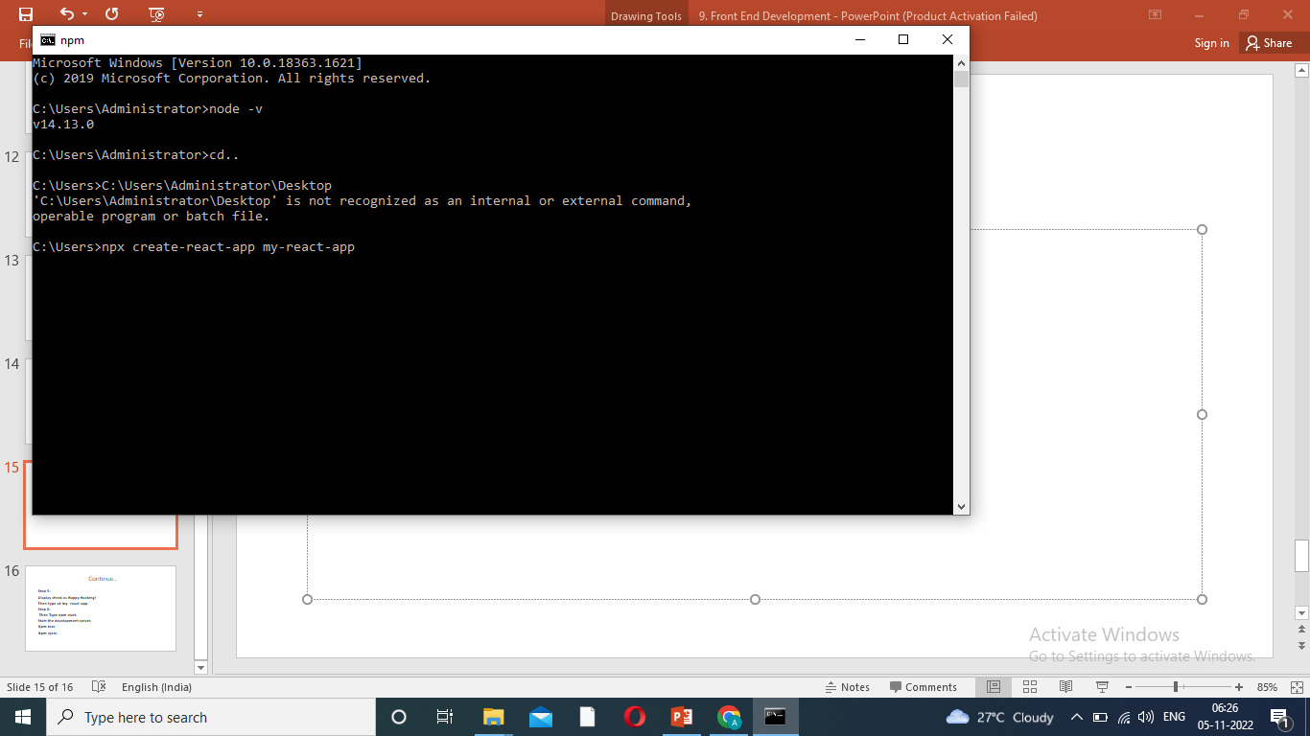
Continue..
Step 4:
Node Package Execute. Then type
npx create-react-app my-react-app
Enter key press and Download Packages.

Slide 16
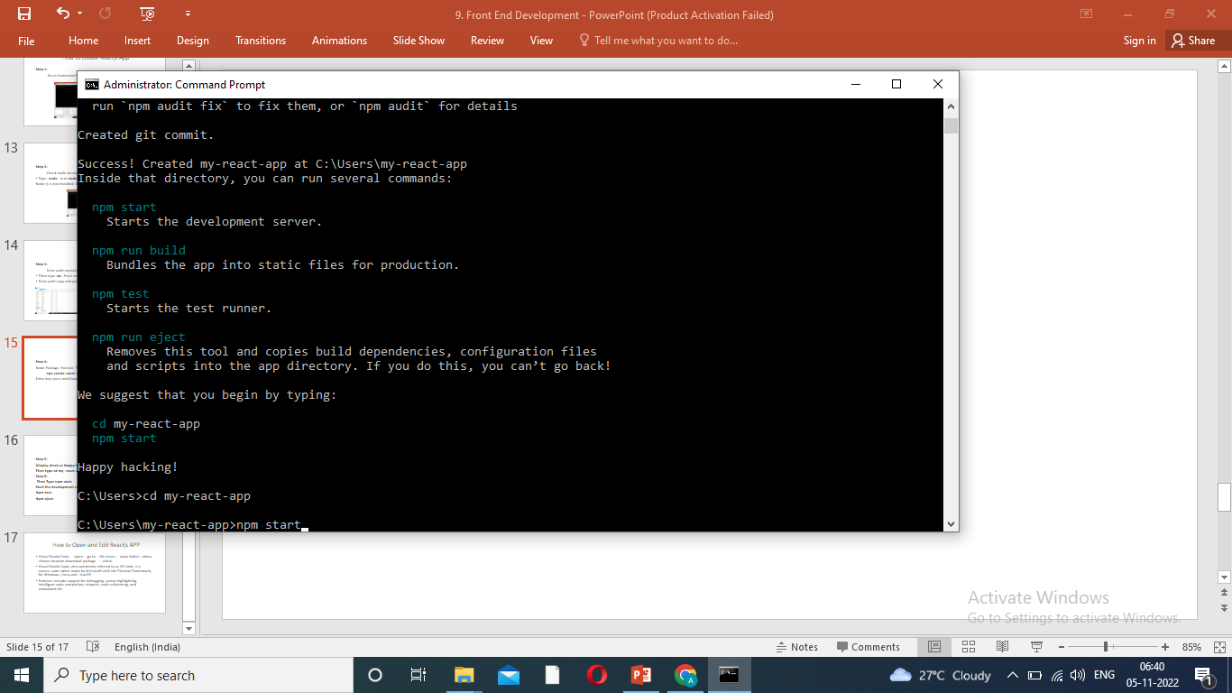
Continue..
Step 5:
Display check as Happy Hacking!
Then type cd my-react-app
Enter.

Slide 17
Continue..
Step 6:
Then Type npm start.

Slide 18
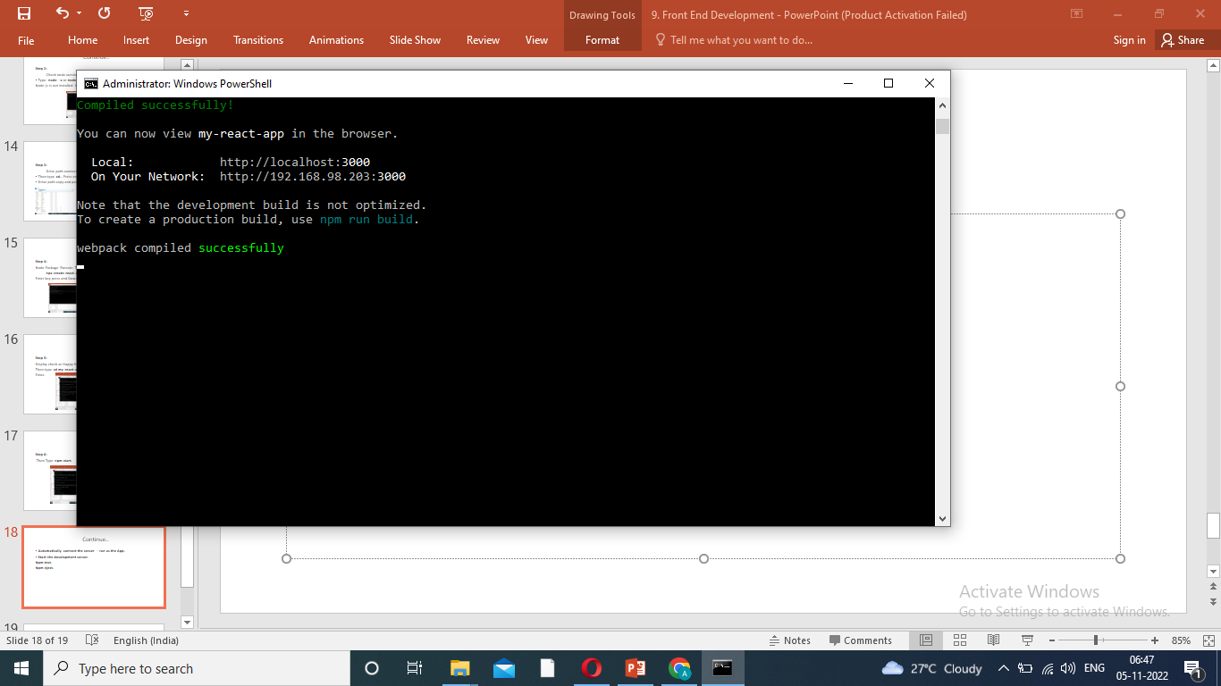
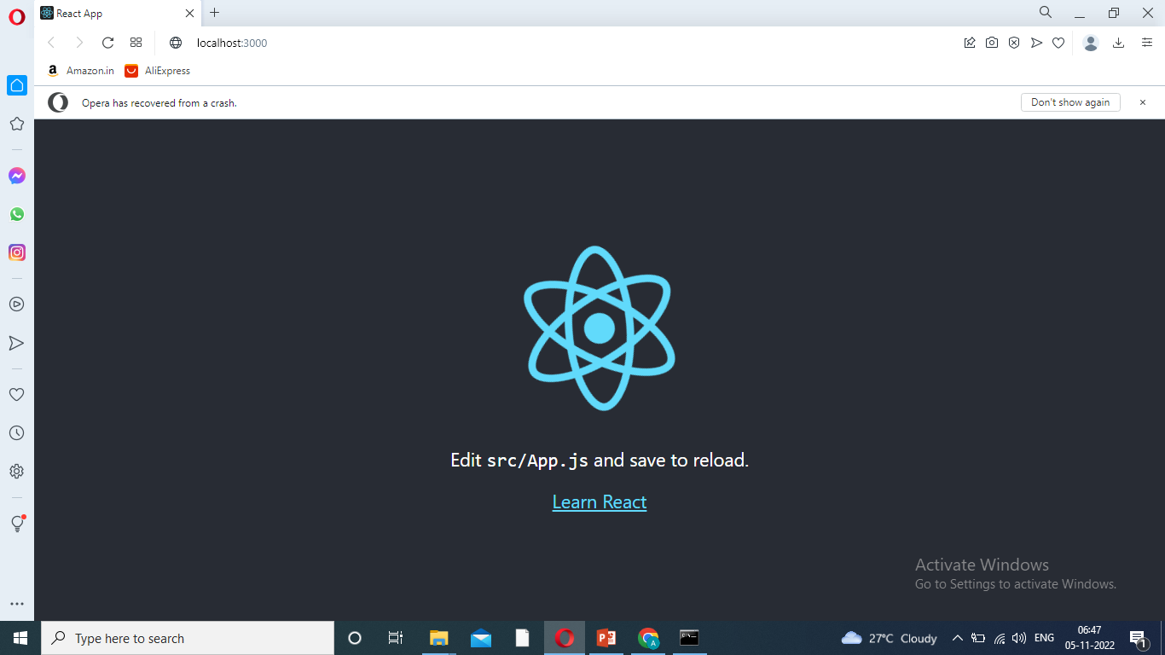
Continue..
Command Complete web pack complied successfully
Automatically connect the server – run as the App.

Slide 19
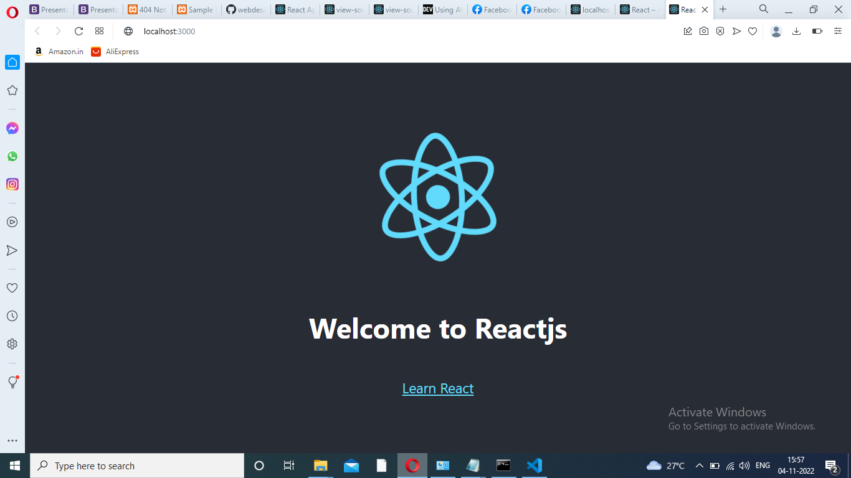
How to Open and Edit Reactjs APP
Visual Studio Code – open – go to – file menu – open folder- above choose location download package – select.
Select src- click-App.js – edit <p></P> - Execute display given below:

Slide 20
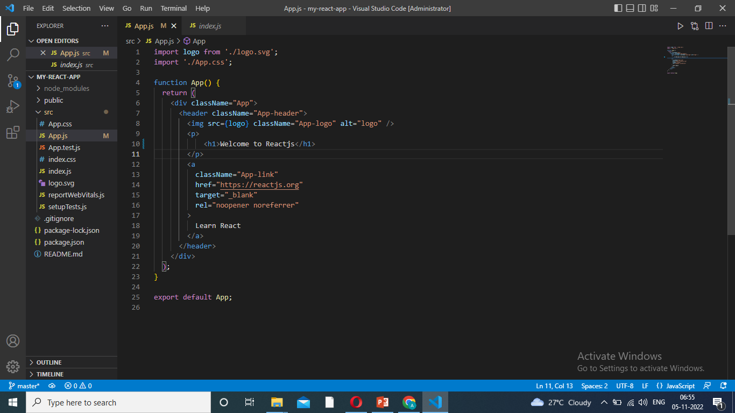
Editing Code

Slide 21
Visual Studio Code
Visual Studio Code, also commonly referred to as VS Code, is a source-code editor made by Microsoft with the Electron Framework, for Windows, Linux and macOS.
Features include support for debugging, syntax highlighting, intelligent code completion, snippets, code refactoring, and embedded Git.

Slide 22
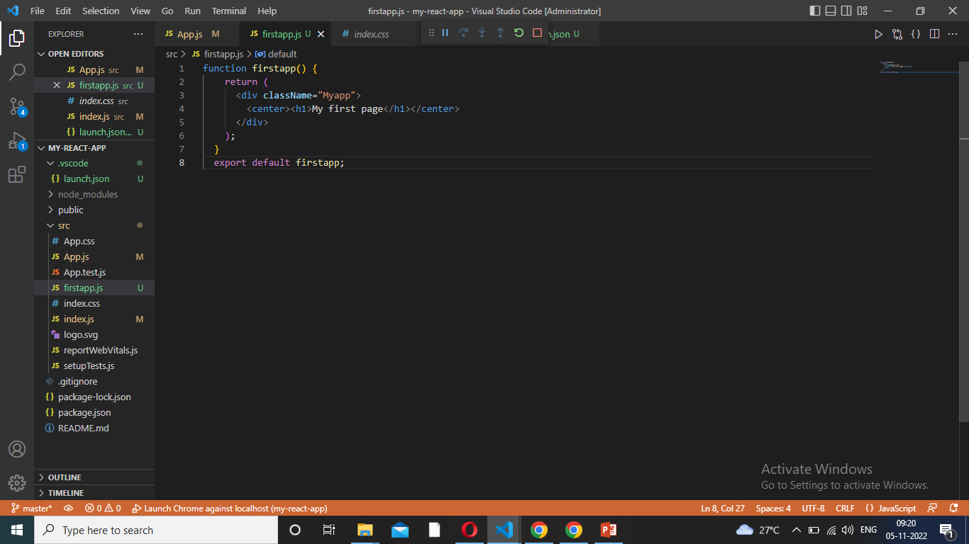
New App Creation
Vs code – Src – right click- new file(app name).js- write the program
export default first-app;

Slide 23
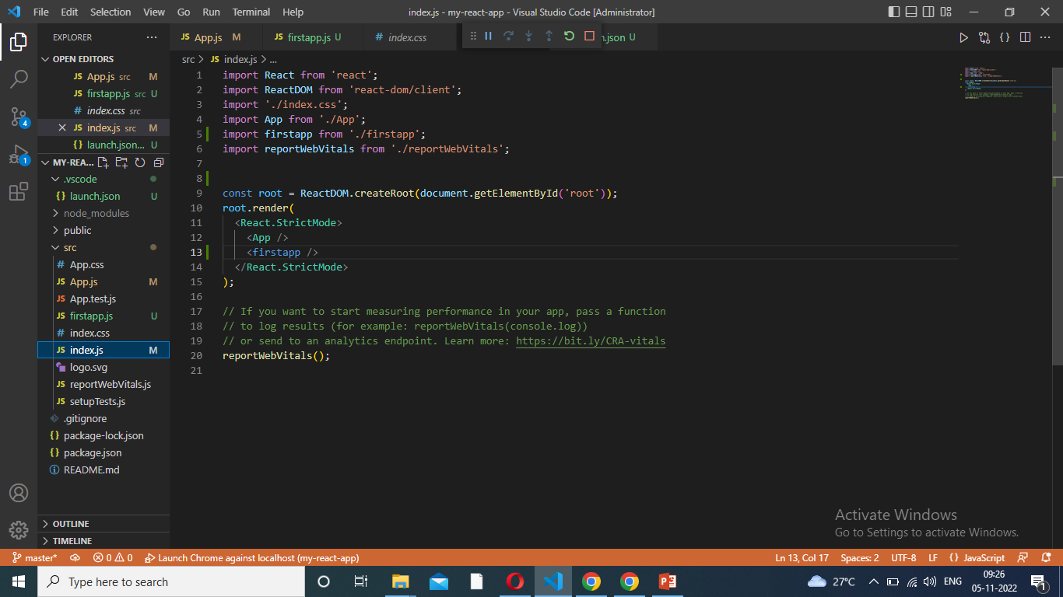
Import
Import the index.js

Slide 24
What is JSX?
JSX stands for JavaScript XML and it is a very useful tool for React developers.
JSX allows us to write HTML in React.
JSX makes it easier to write and add HTML in React.
JSX is a JavaScript Extension Syntax used in React to easily write HTML and JavaScript together.

Slide 25
ES6
ES6 stands for ECMAScript 6.
ECMAScript was created to standardize JavaScript, and ES6 is the 6th version of ECMAScript,
it was published in 2015, and is also known as ECMAScript 2015.

Slide 26
what is components in react js
Components are independent and reusable bits of code.
They serve the same purpose as JavaScript functions, but work in isolation and return HTML.
Components come in two types, Class components and Function components, in this tutorial we will concentrate on Function components.

Slide 27
Class Components
Create a Class component called Car
import React from 'react';
import ReactDOM from 'react-dom/client';
class Car extends React.Component {
render() {
return <h2>Hi, I am a Car!</h2>;
}
}
ReactDOM.render(<Car />,
document.getElementById('root'));

Slide 28
Class Features
Polymorphism is a feature of object-oriented programming languages that allows a specific routine to use variables of different types at different times.
Inheritance is a way to achieve code reusability when some objects have the same number of properties that can be shared across the app. Inheritance allows the app to do the coupling between the parent-child component and reuse properties such as state values and function in its child components.
Function overloading is a mechanism or ability to create multiple methods with the same name but different parameter types and return type.

Slide 29
Features of ReactJs
1. React Native
Uses native, rather than web components to facilitate native React JS development for Android and iOS.
Basically, this feature transforms React code to render it compatible with iOS or Android platforms and provides access to their native features.
2. One-Way Data Binding
This means that React uses a flow of data that is unidirectional, forcing developers to use the callback feature to edit components, and preventing them from editing them directly.
The controlling of data flow from a single point is achieved with a JS app architecture component called Flux. It actually affords developers better control over the app and makes it more flexible and effective.

Slide 30
Features of Reactjs
3. Declarative UI
This feature makes React code more readable and easier to fix bugs. React JS is the best platform to develop UIs that are both exciting and engaging not just for web apps, but mobile apps as well.
4. Component Based Architecture
This simply means that the user interface of an app based on React JS is made up of several components, with each of them having its particular logic, written in JS.
Due to this, developers can relay the data across the app without the DOM being impacted. React JS components play a huge part in deciding the app visuals and interactions.
5. Virual Dom

Slide 31
Node Js
Node.js is an open source server environment
Node.js is free
Node.js runs on various platforms (Windows, Linux, Unix, Mac OS X, etc.)
Node.js uses JavaScript on the server

Slide 32
What Can Node.js Do?
Node.js can generate dynamic page content
Node.js can create, open, read, write, delete, and close files on the server
Node.js can collect form data
Node.js can add, delete, modify data in your database

Slide 33
What is a Node.js File?
Node.js files contain tasks that will be executed on certain events
A typical event is someone trying to access a port on the server
Node.js files must be initiated on the server before having any effect
Node.js files have extension ".js"

Slide 34
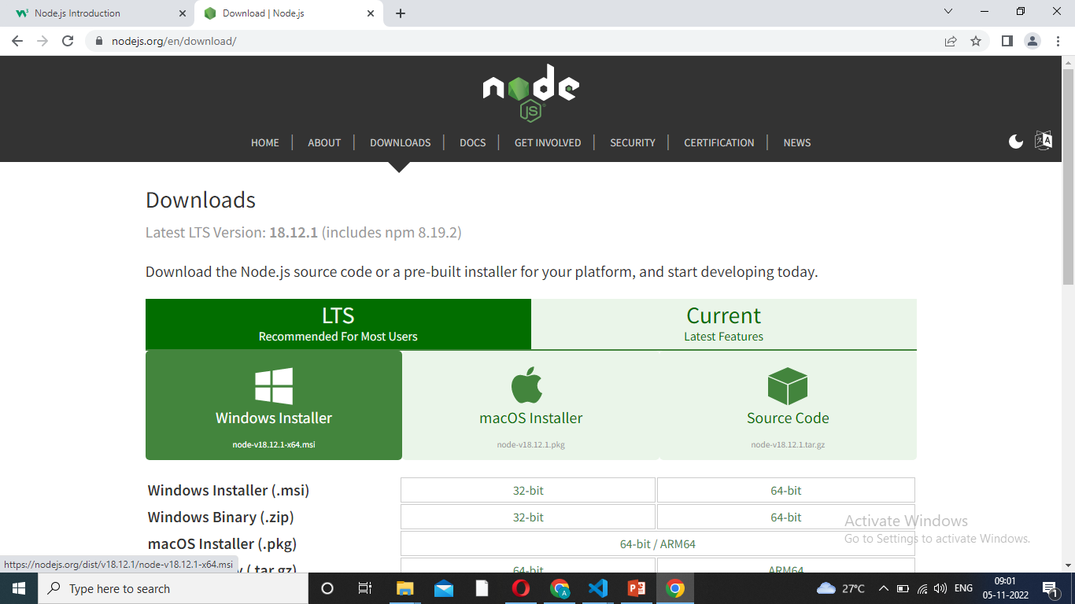
Node Js Download Url
https://nodejs.org/en/download

